Slide 1

UNIVERSITY OF PETROLEUM & ENERGY STUDIES
School of Computer Science Dehradun
COURSE: Physical and IT Security
July – December 2023
Delivered
by
Dr. Gopal Singh Rawat
1

Slide 2
Course Plan
CO1. Introduction to Physical Security CO2. Approaches to Physical Security
CO3. Standards, Regulations and Guidelines
CO4. Fire and Fire Safety Inspection CO5. Vulnerability Assessment CO6. Security Surveys and Audit CO7. Security Lighting, Alarms
CO8. Video, Biometrics, Access Control, Fences CO09. Security Personnel
2

Slide 3
Chapter 5. Vulnerability Assessment

Slide 4
5.1 Critical IT Security Terms
Asset (A):
Asset is what we’re trying to protect.
E.g. People → Employees, Customers, Vendors, Guests
E.g. Property → Tangible (measure / can be assigned a value) and intangible (Reputation, IP Info)
E.g. Information → Documents, Databases, Software code, Critical company record.
Vulnerability (V):
This is a Weaknesses or Gaps in a security program or protection efforts.
Can be exploited by Threats to gain unauthorized access to an asset.
E.g. Lock is vulnerable to the physical attack
Threat (T):
A threat is what we’re trying to protect against.
Anything that can exploit a vulnerability (intentionally or accidentally) to obtain, damage, or destroy an asset.
E.g. Intruder can break open a door that has a weak/small lock
E.g. Malware, Phishing, Social Engineering, Internal Agents, Your unpatched devices

Slide 5
5.1 Critical IT Security Terms
Attack:
Someone following through on a threat or exploiting a vulnerability
Malicious action taken that uses one or more vulnerabilities to realize a Threat and exploits the vulnerability
E.g. Illegal / Unauthorized Remote Access / Privilege Account access
Countermeasure:
Mitigation plan to addresses a vulnerability
Reduce the probability of an attack or the impact of a threat.
E.g. OS patching (scanner report), Network Port Block on Firewall
Risk (R):
Intersection of assets, threats, and vulnerabilities → R = A + T + V
Potential for loss, damage or destruction of an asset as a result of a threat exploiting a vulnerability.
Note:
Threats (Actual, Conceptual, or Inherent) may exist, but if there are no vulnerabilities → then there is little/no risk.
You can have a vulnerability, but if you have no threat → then you have little/no risk.
E.g. Resources inside the office premise are prone to illegal/unauthorized access/damage

Slide 6
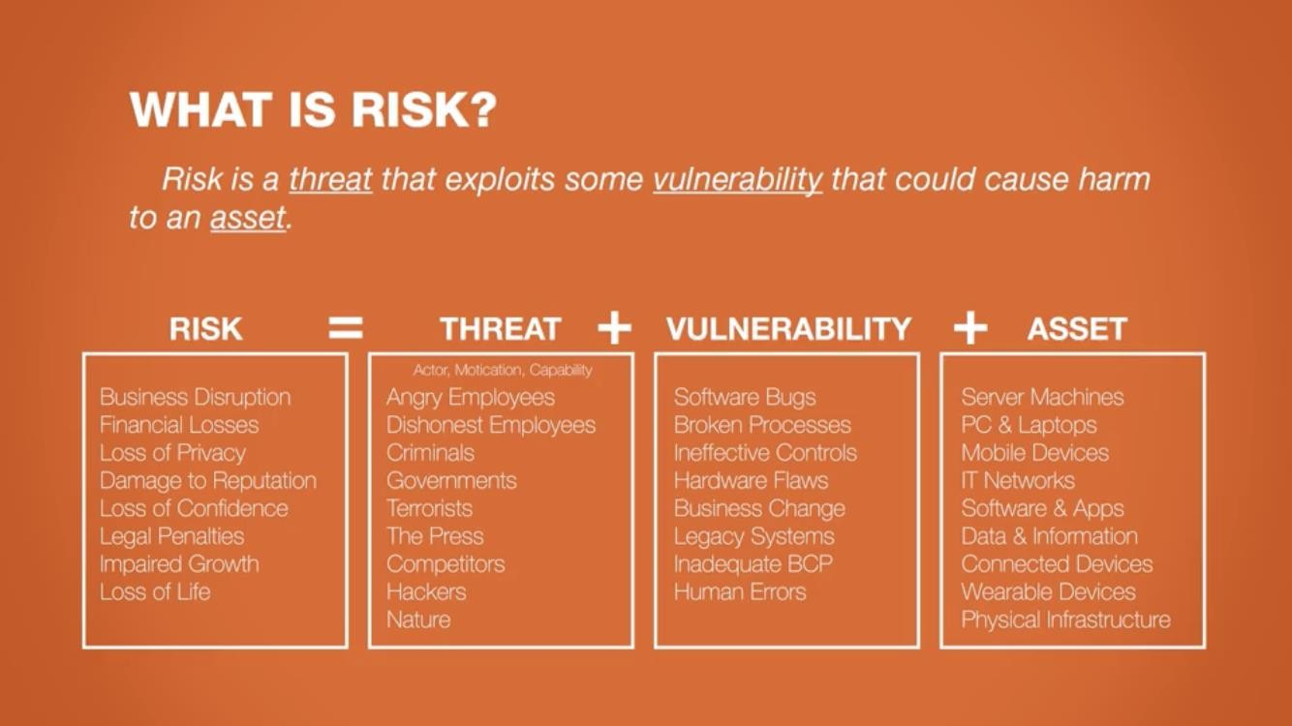
5.1 Critical IT Security Terms

Slide 7
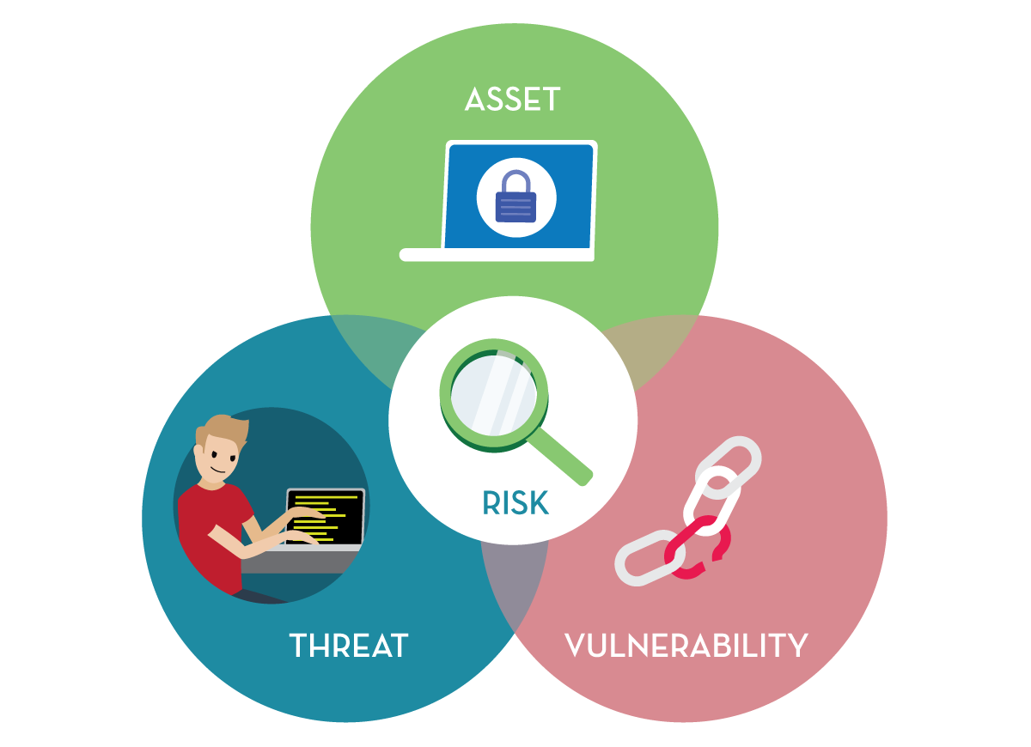
5.1 Critical IT Security Terms

Slide 8
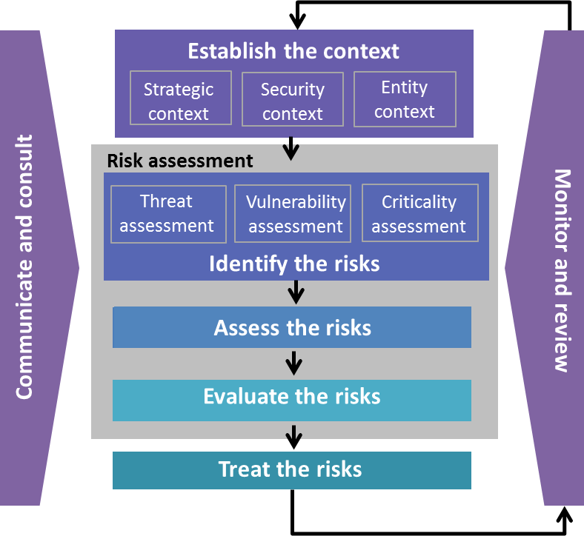
5.2 Vulnerability Assessment (VA)
Sub process / part of Risk Management
Answers questions
What is the likelihood of being hit by a Threat?
What is the result of the attack incident?
What is the acceptance ratio of the results?
VA under Physical Security process:
Understand Security Functions and Systems
Identify Vulnerabilities
Understand Physical Design of Organization
Recommend Security Improvements
Threat Assessment:
Determine likelihood of adverse events impacting Assets
Validate security levels.
Criticality Assessment:
Systematic approach to evaluating potential risks
Determine consequences that can impact the business

Slide 9
5.3 Physical System Vulnerability Assessment Process
Physical Vulnerability Assessment methodology has the following objectives:
Understand Organization’s Security Functions and Systems
Identify Vulnerabilities which may affect the objectives of the organization
Understand Operations associated with organization’s Physical Design → modes of failures can be determined
Reduction of vulnerabilities by recommending improvements that can be carried out in the organization
Following are the seven steps for Physical System Vulnerability Assessment:
Step 1:
Asset Classification / Grouping
Step 3: Threat
Identification /
Threat Sources
/ Agents
Step 2:
Asset Valuation
Step 4: Vulnerability Assessment
Step 5:
Impact Determination
Step 6: Likelihood Determination
Step 7:
Risk Determination

Slide 10
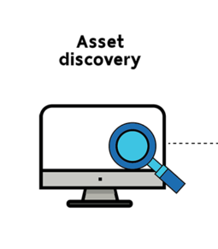
5.3 Physical System Vulnerability Assessment Process
#1 Asset classification
Assets that can be present in an organization:
Physical assets e.g. Physical Infrastructure assets, Computer Systems
Software assets e.g. Media
Information assets e.g. shared folders, hardcopies
Service assets e.g. Security & housekeeping services, IT Helpdesk
Human resource e.g. VP’s, Managers, Associates
Asset grouping:
Group together as per type
Information: Data and Documents (databases, data files, contracts, agreements, system documentation, research information, user manuals, training material, audit trails, archived information)
Software assets: Application software, system software, development tools, utilities

Slide 11
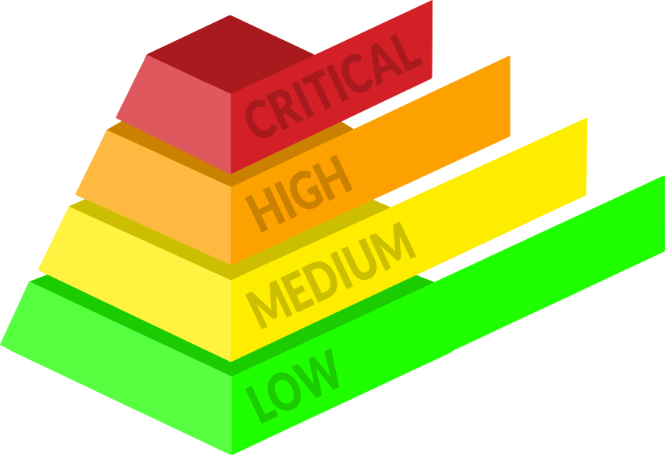
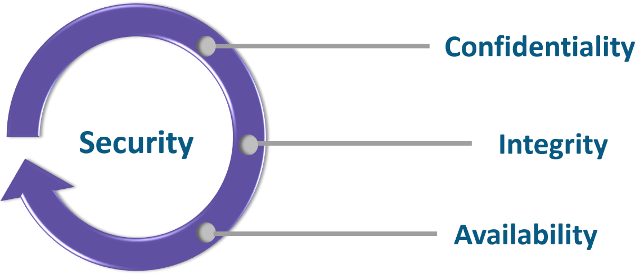
5.3 Physical System Vulnerability Assessment Process
# 2 Asset valuation:
Dependent & derived from C (Confidentiality), I (Integrity) and A (Availability) individual ratings / values.
Asset value is determined by either method given below:
Addition Method: C + I + A = AV
Multiplication Method: C * I * A = AV
Aggregated Method: (C + I + A)/3 = AV

Slide 12
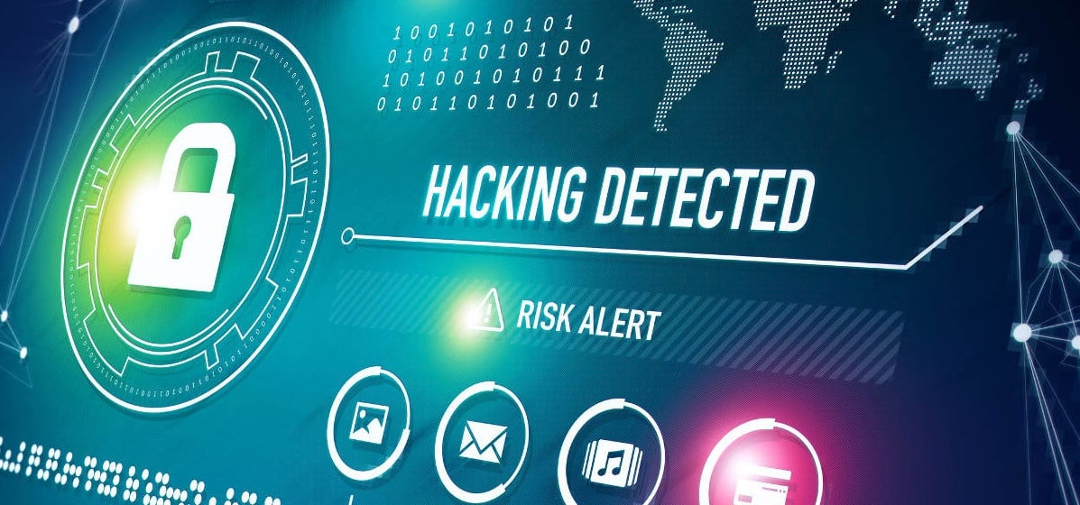
5.3 Physical System Vulnerability Assessment Process
#3 Threat identification
Following activities are carried out in this phase:
Any potential occurrence of threat-source that exploits a specific vulnerability
Identification must consider
source or agent of threat
potential vulnerabilities
existing controls
past history
information from interested groups, etc.

Slide 13

5.3 Physical System Vulnerability Assessment Process
#4 Vulnerability Assessment
Activities that are carried out in this phase:
Weakness / flaw - safeguard
Identification must consider
source of threat
threat action
audit reports (Non-Conformances)
past assessment reports
special interested groups, etc.

Slide 14
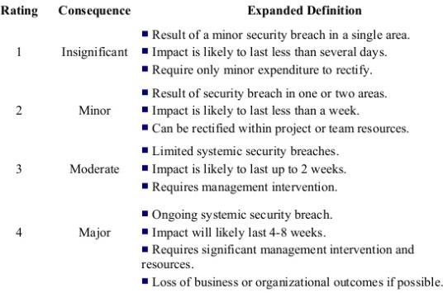
Physical System Vulnerability Assessment Process
#5 Impact Determination:
Below are the points involved in this step:
Adverse impact resulting from successful threat exploit of vulnerability
Identification must consider the Individual Asset value and exposure rating, also the overall criticality of asset or
exposure, Business Impact Analysis (BIA).
Impact can also be determined based on loss of confidentiality, loss of integrity and loss of availability

Slide 15
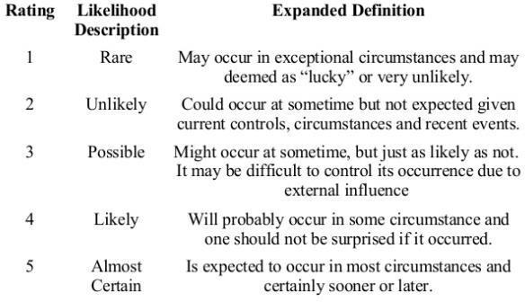
Physical System Vulnerability Assessment Process
#6 Likelihood Determination:
Indicates the probability that potential vulnerability may be exploited with associated threat and environment
Determination must cover the Threat source, Nature of vulnerability, and effectiveness of current controls

Slide 16
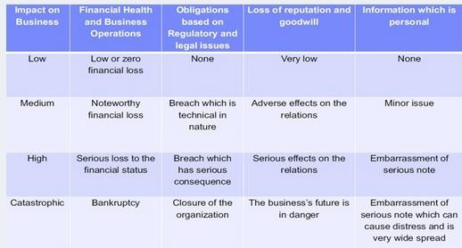
5.3 Physical System Vulnerability Assessment Process
#7 Risk Assessment:
Based on the identification of Threats
Associated Vulnerabilities
Determination of Impact
Determination of Likelihood
After all these factors are determined then risk can be assessed.

Slide 17
5.4 Risk Determination
Risk Determination assess the level of risk to the system.
Following points should be considered for risk determination:
Likelihood of a threat exploiting a given vulnerability
Magnitude of the impact
Adequacy of existing controls (in– order to reduce or eliminate the overall risks)

Slide 18
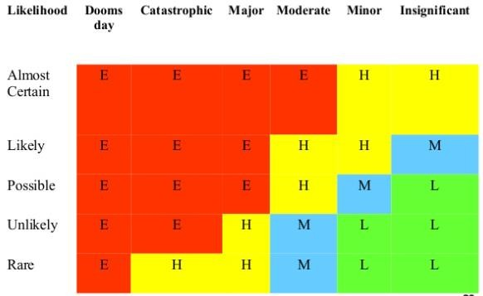
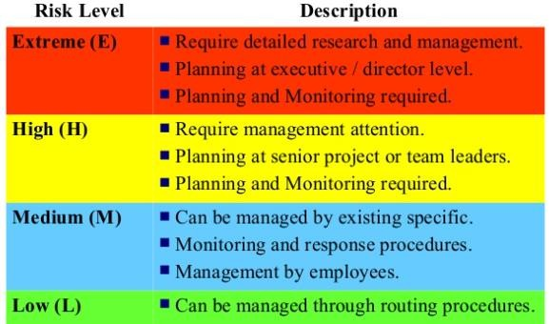
5.4 Risk Determination
Risk Determination
Risk Determination

Slide 19
5.5 Examples of Threat Agents and Threat Elements
Threats | Elements
Accidents | Fire, Smoke, Structure / Building
Criminal Activity | Arson, Personal Assault, Vandalism
Sabotage | Tempering, Data Manipulation/Theft, Malicious insiders (internal agents)
Terrorism | Bombs, Explosion, Kidnaping, Attacks
Information Warfare | Malwares, Network Eavesdropping, DoS, Exploits, Ransomware
Civil Unrest | Riot, Looting, Widespread Arson
Natural Disasters | Earthquake, Floods, Storms, Jungle Fires, Avalanche
Conventional Weapons | Missiles, Rockets, Bombs, Guns
Weapons of Mass Destruction | Nuclear, Chemical, Radiological, Biological

Slide 20
5.6 System Engineering and Vulnerability Assessment
Collection of various components integrated to achieve a certain goal is known as a system
Features of a system
Holistic approach
Various subsystems
Can be deployed in any organization
An integrated approach to make the systems realize successful outputs is known as system engineering
Focus points of System Engineering
Customer requirements
System functioning
System design
System validation

Slide 21
5.6 System Engineering and Vulnerability Assessment
Aim of System Engineering:
Provide product which is high in quality and meets requirements specified by customers
Consider points while delivering product:
Safety
Reliable
Maintenance
Technical performance
Involved personnel
Cost involved during lifecycle
Step 1:
Requirement
Step 2:
Design & Analysis
Step 3:
Installation & Testing
Step 4: Replacement

